Slide 1
Zero Down-Time, Automated Deployments
How to use Amazon Code Deploy and Jenkins to deploy your code automatically without taking down your website

Slide 2
Amazon Code Deploy
Benefits
Concepts
Deployment Process
Setup Work
Demo

Slide 3
Amazon Code Deploy - Benefits
Automated
Repeatable
Simple
Zero Down-Time
Scalability

Slide 4
Amazon Code Deploy - Concepts
Application
Deployment Group
Deployment Configuration
Revision
Deployment Manifest (AppSpec.yml)
Notes:
Application = Container
Deployment Group = WHERE to deploy – tags on EC2 instances
Deployment Configuration = HOW to deploy – e.g, One at a Time VS Half at a time VS All at Once
Revision = WHAT to deploy
AppSpec.yml = Deployment Manifest – Files and Scripts

Slide 5
Amazon Code Deploy – Deployment Process
Code is compiled
PowerShell scripts are signed
AWS DEPLOY PUSH command
Deployment is triggered
Each server deploys the code on your behalf
Notes:
Compile to a local folder
Server should have PowerShell Execution Policy set to “All Signed” or “Remote Signed” – NOT “Unrestricted”!
PUSH command: YAML file + Compiled Code + Scripts are ZIPped, pushed to S3, and associated to Application
Deployment can be triggered via API, CLI, or AWS Console
Each server IN THE DEPLOYMENT GROUP deploys code via Code Deploy Agent

Slide 6
Amazon Code Deploy – Account Setup
Create S3 bucket to hold Revisions
Create a Code Deploy Application
Write AppSpec.yml and event scripts
Create and distribute code-signing certificate for PowerShell scripts

Slide 7
Amazon Code Deploy – Server Setup
Launch EC2 instance in an IAM Role
Assign permissions to EC2 IAM Role
Install AWS Code Deploy Agent
Tag EC2 instance for Deployment-Group
Deploy code-signing certificate
Set PowerShell Execution Policy to All Signed
Notes:
May have to re-launch EC2 instance
-
Installing Code Deploy Agent is a one-time task
-
-
Set-ExecutionPolicy -ExecutionPolicy AllSigned -Scope LocalMachine

Slide 8
Amazon Code Deploy – AppSpec.yml
version: 0.0 os: operating-system-name files: source-destination-files-mappings permissions: permissions-specifications hooks: deployment-lifecycle-event-mappings
Reference: http://docs.aws.amazon.com/codedeploy/latest/userguide/app-spec-ref.html

Slide 9
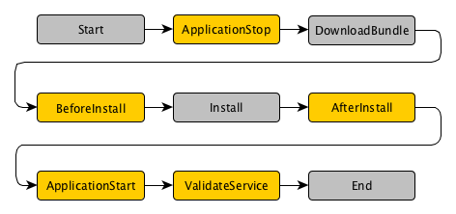
Amazon Code Deploy – AppSpec.yml Events
ApplicationStop - used to gracefully stop the application/service.
BeforeInstall - typically used to create a backup of the current version, or delete all files from the target folder
AfterInstall - might be used to configure the application, set file permissions, or swap folders
ApplicationStart - typically used to restart the application/service
ValidateService - typically used to verify the deployment was successful
Notes:
NOTE: The ApplicationStop script from the previous revision is what's actually run.

Slide 10
Demo

